Slide 1

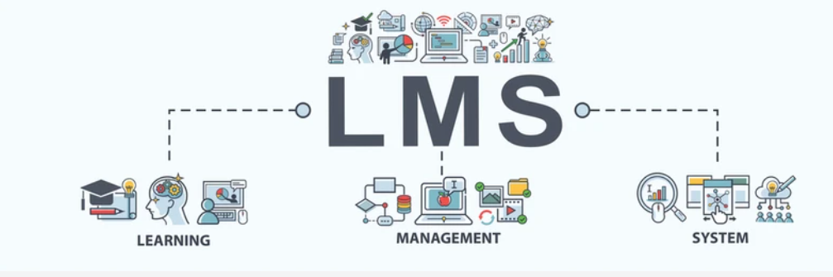

Slide 2
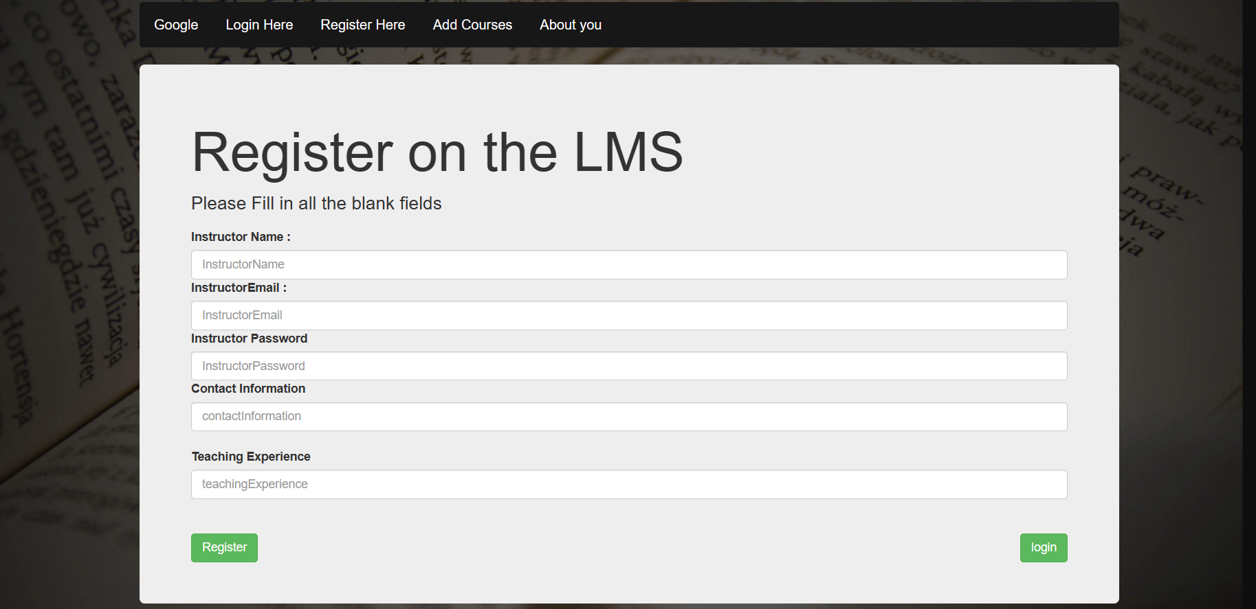
Intro on LMS
Is a software application for
managing training and education.

Slide 3


What is the project all about
A website for Educational fields and it can help them to control the Courses and the Instructors.

Slide 4

project requirement
## Instructor Side (Dashboard)
## Student Side (API)
## Principal Side (Dashboard)

Slide 5
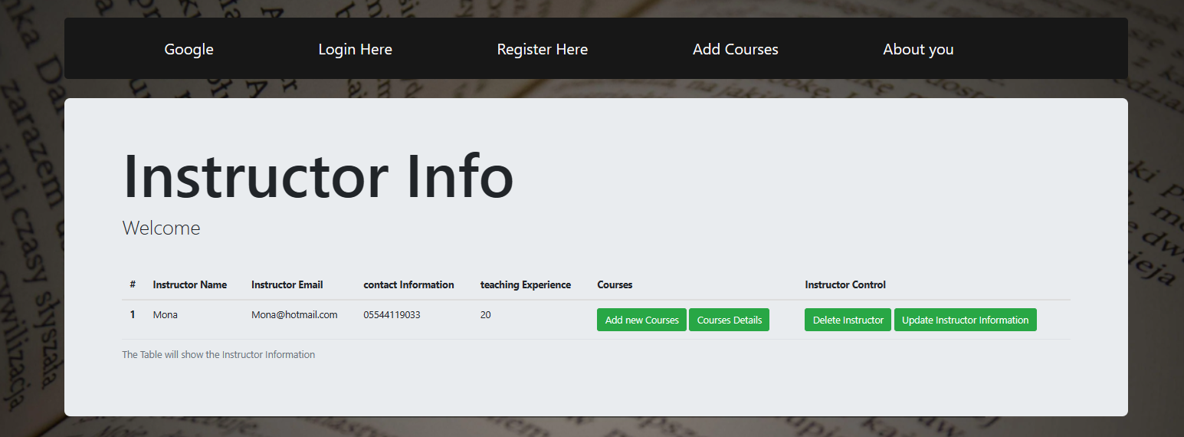
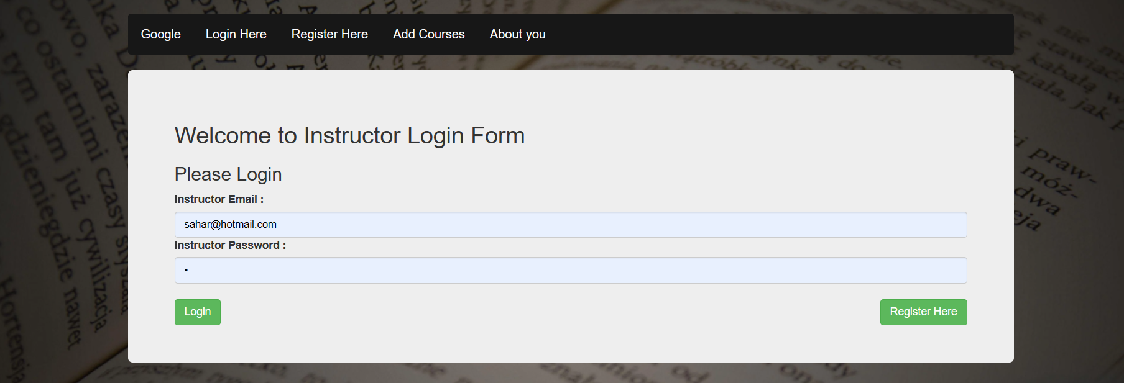
Design the project

Slide 6



Used technologies
HTML5
CSS3
JavaScript

Slide 7




Used TOOLS
VS code
Chrome
GitHub

Slide 8
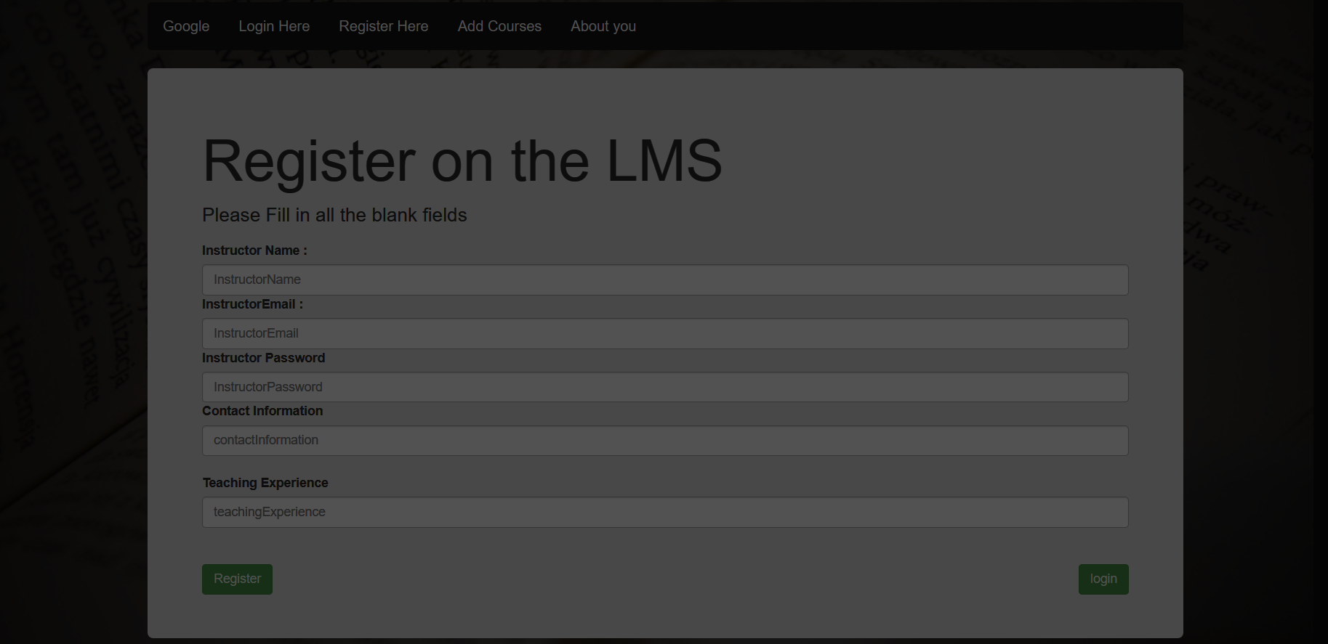

Demo

Slide 9

THANK YOU

